Slide 1
PROJECT REPORT

Slide 2
HG SURVEY (20 JAN 2018)
S.no. | Started on | Auto at stand | Coming | Going | Passing
1 | 1:48 pm | 15 | (1) (0) (0)(3) | (5) | (4) (0e) (2)
2 | 1:53 pm | 18 | (2) | (5) (0) | (3)
3 | 1:58 pm | 17 | ----- | (5) | (4) (0) (2)
4 | 2:03 pm | 16 | (1) | -------- | (4) (0) (0) (0) (0) (0)
5 | 2:08 pm | 17 | ------ | (5) | (4) (4) (5)
6 | 2:13 pm | 16 | (1) (0) | (5) (5) (4) | (4) (2) (4)
7 | 2:18 pm | 15 | ------ | ------- | (0)
8 | 2:23 pm | 15 | (2) (2) | (3) (4) | (5) (4)
9 | 2:28 pm | 15 | ----- | ----- | (0) (5)
10 | 2:33 pm | 15 | ----- | (4) (3) | (3) (4) (1) (5)
11 | 2:38 pm | 13 | ----- | (5) | (3,2d) (0) (0)
12 | 2:43 pm | 12 | ----- | (4) | (3)
13 | 2:48 pm | 11 | (1) | (5) (4) | (3) (1) (5)

Slide 3
SOME ADDITIONAL STATEMENT
1:48 pm 1 auto waiting with 1 passenger +1+1+2 go at 1:57 pm. (9 min)
1:58 pm 1 auto waiting with 2 passenger+3 go at 2:01 pm. (3 min)
1:57 pm go and stand in front of SN BOSS
2:01 pm 1 auto waiting with 1 passenger+1+3 go at 2:08 pm. (7 min)
2:09 pm 1 auto waiting with 2 passenger+3 go at 2:15 pm. (6 min)
2:11 pm 1 auto waiting with 4 passenger+1 go at 2:16 pm. (5 min)
2:13 pm 1 auto waiting with 2 passenger+2 go at 2:17 pm. (4 min)
2:17 pm 1 auto waiting with 2 passenger+2 go at 2:26 pm. (9 min)
2:18 pm 1 auto waiting with 2 passenger+2 go at 2:35 pm. (17 min)
2:20 pm 1 auto waiting with 2 passenger+1 go at 2:37 pm. (17 min)
2:36 pm 1 auto waiting with 3 passenger+2 go at 2:39 pm. (3 min)
2:40 pm 1 auto waiting with 1 passenger+3 go at 2:43 pm. (3 min)
2:43 pm 1 auto waiting with 1 passenger+3+1 go at 2:48 pm. (5 min)
2:47 pm 1 auto waiting with 3 passenger+1 go at 2:52 pm. (4 min)

Slide 4
Health Centre (20 JAN 2018)
From 3:14 PM to 3:50 PM only three auto passes.
No one comes to health centre that day (Saturday)

Slide 5
Vishwanath Temple (21 Jan 2018)
S. no. | Started on | Auto at stand | Coming | Going | Passing
1 | 1:43 pm | 7e, 10 | (3) | (0) (5) (3) | (0) (2) (5) (3) (2) (5)
2 | 1:48 pm | 7e, 8 | (5) | (2) (3) (4) | (5) (0e)⁵ (4) (2e) (0,p3)
3 | 1:53 pm | 7e, 6 | (5) (4) | (5) (0) (2) | (3,d1) (3,d1) (4,p1)
4 | 1:58 pm | 7e, 5 | (0e) | ------- | (4) (3) (2,d2)
5 | 2:03 pm | 8e, 5 | (3) (5) (4) | (5e) | (5) (4) (5)
6 | 2:08 pm | 7e, 8 | ------ | (5) | (3,d1) (6,d2) (2) (0,p3)

Slide 6
SHEER GATE (21 Jan 2018)
4:13 PM to 4:42 PM
There was not any single auto present
There were 6 riksha there.
Five got customer in half hour.

Slide 7
Vishwanath Temple Right (22 Jan 2018)
S. no. | Started on | Auto at stand | Coming | Going | Passing
1 | 3:00 pm | 3e, 6 | (3) | (4) (4) | (4) (3) (5) (0)
2 | 3:05 pm | 3e, 5 | ----- | (4) | (3) (2) (5) (5,d2) (0)
3 | 3:10 pm | 3e, 4 | (3) (0) (2)(0) (3)(3) | (5e) (3e) | (2) (1e)
4 | 3:15 pm | 1e, 10 | ------ | (4) | (1) (1) (3) (0e) (0)

Slide 8
Vishwanath Temple Left (22 Jan 2018)
S. no. | Started on | Auto at stand | Coming | Going | Passing
1 | 3:24 pm | 3e, 2 | (5)(0) (2) (4e)(5e) | (5) (5) (4) (5e) | (5) (4e) (3e,d3)
2 | 3:29 pm | 4e, 2 | (0) (0)(4) (2)(3e)4(0e) | (4e)(4) (5) (4e) | (2e)(3)(5) (5) (5)(4)
3 | 3:34 pm | 4e, 4 | (0) (0) (5e) (5) (3)(2) (0) | (3e) (5e) (5) (3) (4e) (5) (4) (5e) (0) | (4) (5e)
4 | 3:39 pm | 1e, 5 | (2) (5) (5) (5e) (2) (0) | (5) (4) (4) (2) (3) (3) (4) (5) | (3) (2)

Slide 9
Vishwanath Temple (13 Jan 2018)
S. no. | Started on | Auto at stand | Coming | Going | Passing
1 | 3:38 pm | 8 | (2) | -------- | (d3) (0)
2 | 3:50 pm | FTC | ----------- | -------- | (3)
3 | 3:55 pm | 6 | ----------- | (3) | (d6e)
4 | 4:00 pm | 5 | (0) | (3) | (0e)
5 | 4:05 pm | FTC | ----------- | --------- | (0)
6 | 4:15 pm | 4 | (3) | (0) | (p2) (d2) (d5)
7 | 4:20 pm | FTC | ---------- | (4) | -----------
8 | 4:25 pm | 5 | (0) (0) | (2e) (4) | (d2) (d3)
9 | 4:35 pm | 5 | (0) (0) (0) | (4) | -----------
10 | 4:40 pm | FTC | ------------ | (1) (0e) | (0)

Slide 10
LANKA GATE (22 Jan 2018)
S. no. | Started on | Auto at stand | Coming | Going | Passing
1 | 3:42 pm | 5e, 4 | (4) (5) (6) (4) (4e) (7) (4) (5) | (3) (6) (4) (4) (5) (4e) (5) (4) (4e) (6e) | (5) (7) (5)
2 | 3:47 pm | 3e, 4 | (5)(0) (6) (5) (5) | (4) (2e) (5) (5) (0) | (5) (6) (8e) (0e) (0e)
3 | 3:52 pm | 2e, 5 | (5) (5) (5) (5) (5) (5) (2) | (0) (3) (0) (0) (1) (4) (5) | (0)
4 | 3:57 pm | 2e, 6 | (5) (5e) (0) (2) (5e) | (1) (2) (4e) (5e) (4) (4e) (2) (3) (4e) (5)
5 | 4:02 pm | 1e, 3 | (3) (0) (3) (3) | (4) (5) | (4e) (1) (5)
6 | 4:07 pm | 1e, 5 | (0) | -------- | --------

Slide 11
Morvi Hostel (13 Jan 2018)

Slide 12
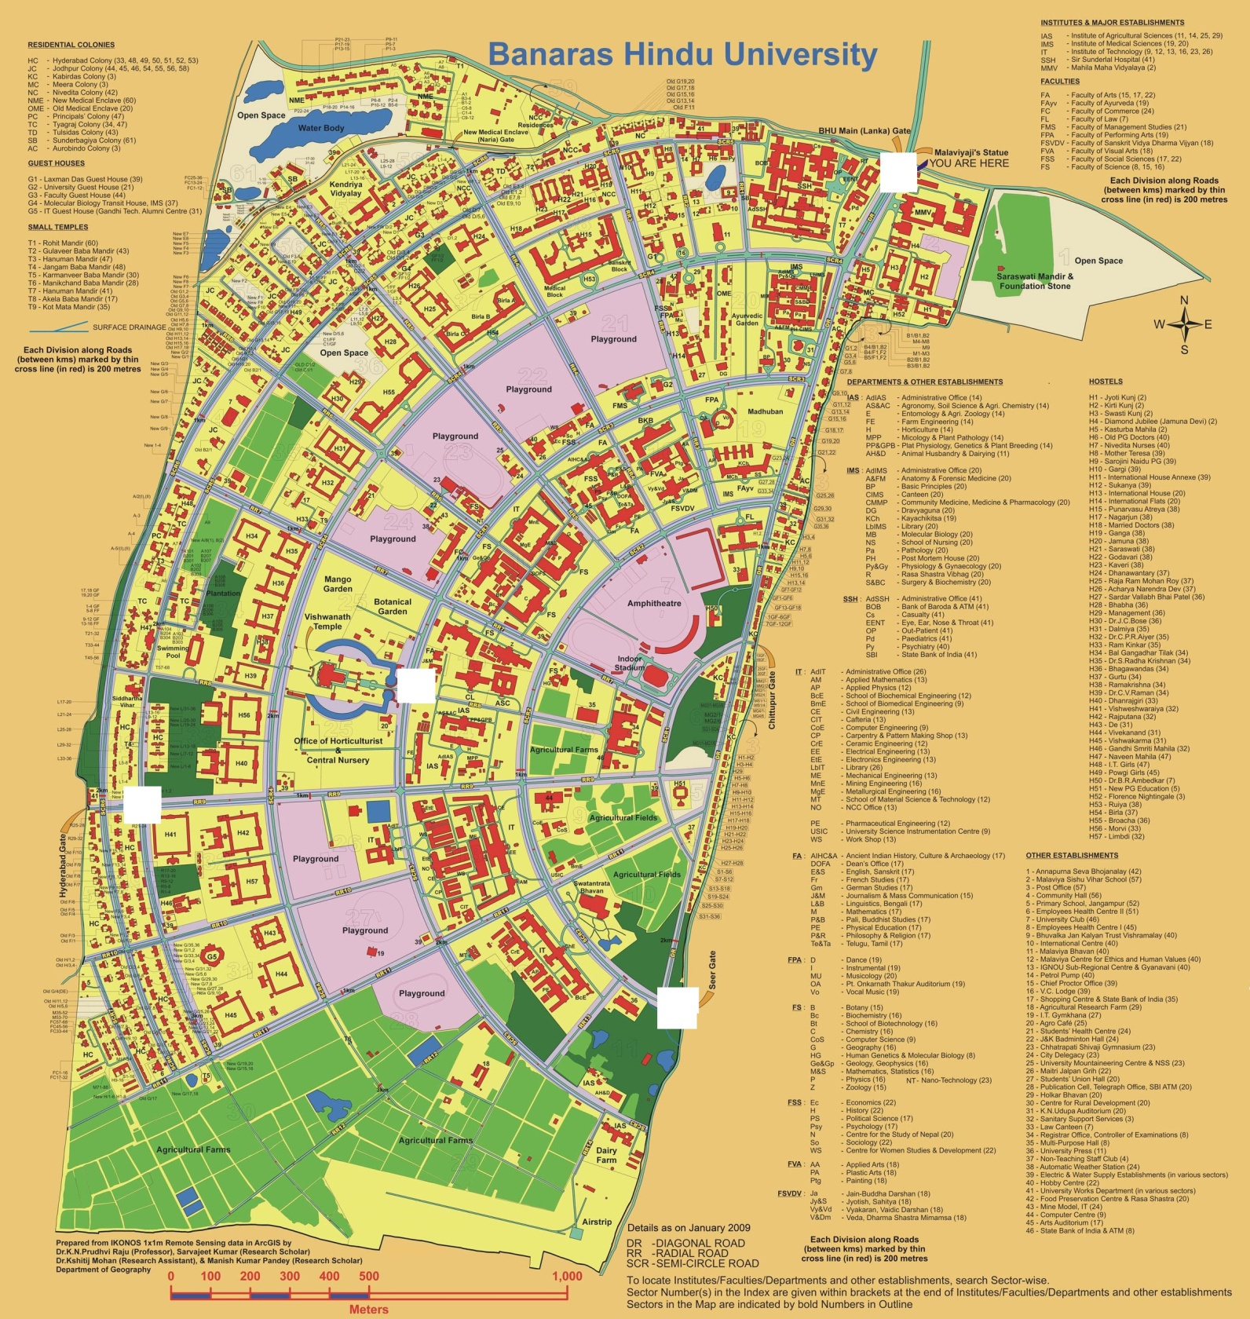
BHU Map

Slide 13
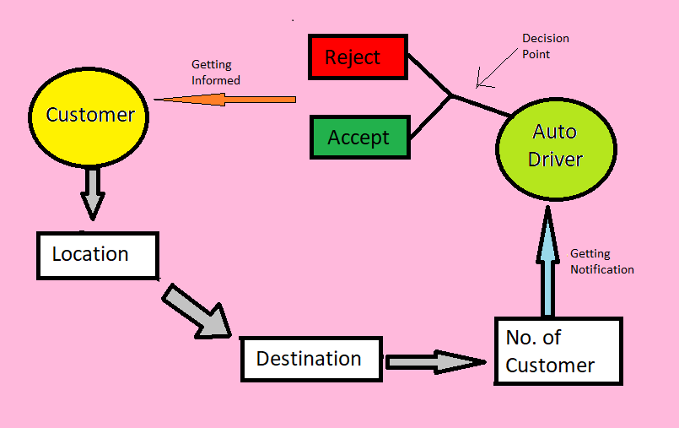
Flow Diagram of Opration

Slide 14
THANK YOU

